Slide 1
AME20216 – Lab I Intro to Probability

Slide 2
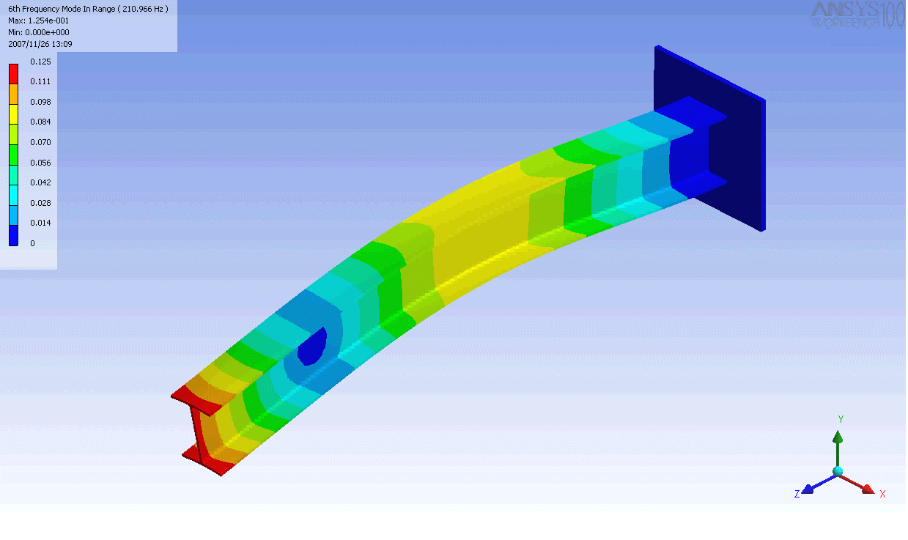
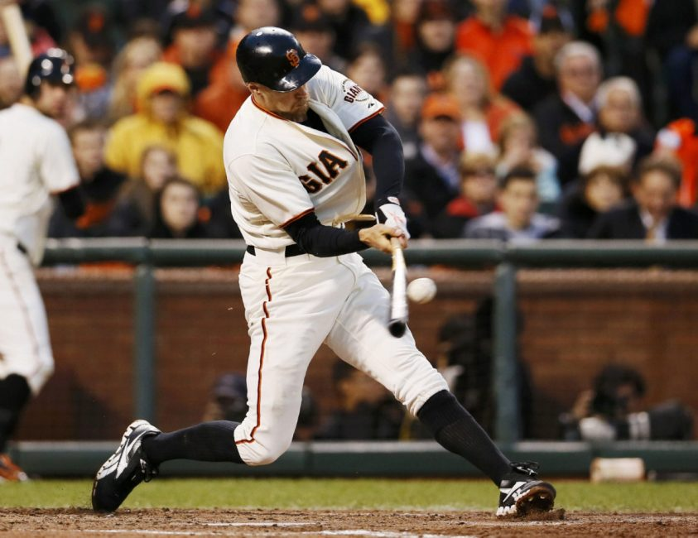
A10 - Cantilever Vibrations
Baseball bat undergoes cantilever vibrations after striking a ball.

Slide 3
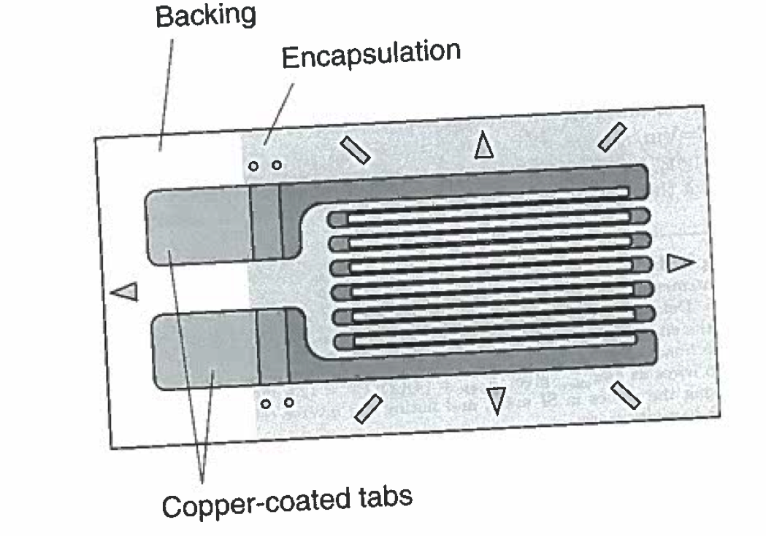
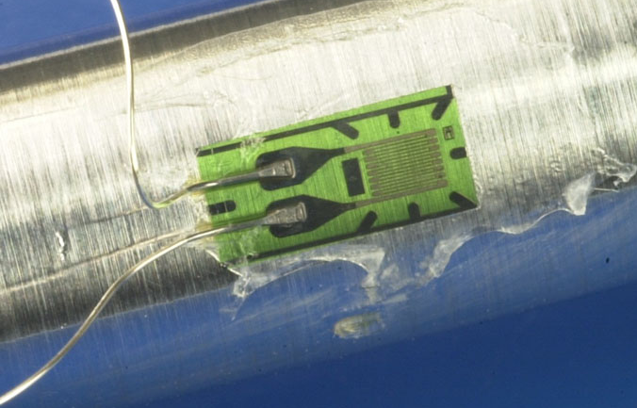
Strain Gauge (or Gage)
Measures strain based on change in resistance
G_{e} ≈ 2 “gage factor”
Fig. 4.4
Often wired up in a Wheatsone bridge configurartion

Slide 4
Single pendulum: Predictable motion
One degree of freedom: θ
Damped harmonic oscillator

Slide 5
Double pendulum: Chaotic motion
Two degrees of freedom: θ₁ and θ₂ .

Slide 6
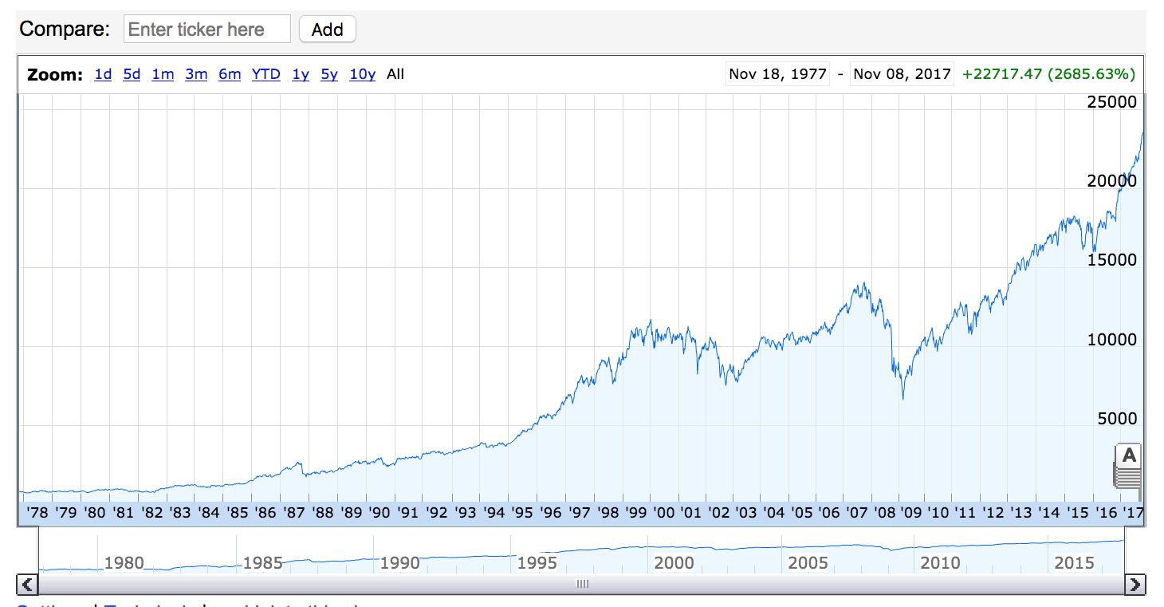
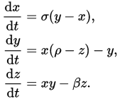
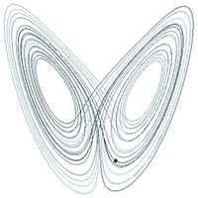
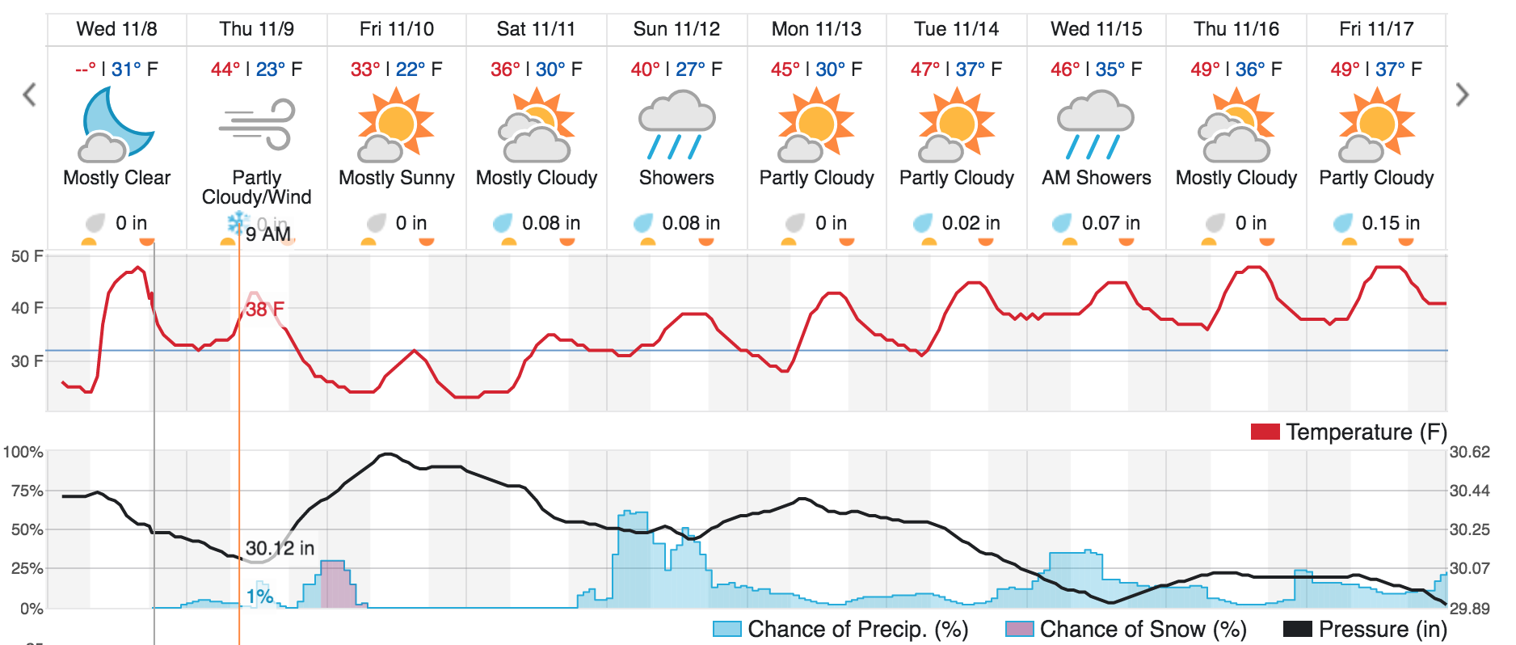
Chaos!
Complex systems are extremely sensitive to initial conditions.

Slide 7
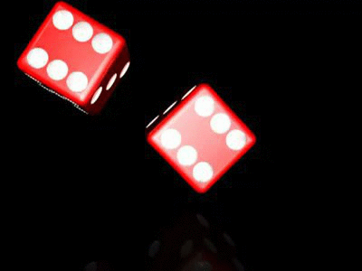
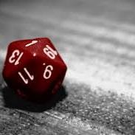
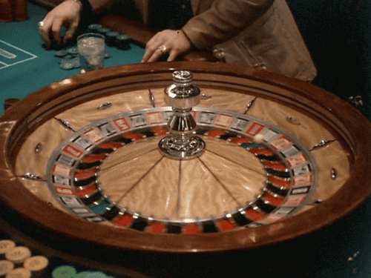

Unpredictable Systems

Slide 8

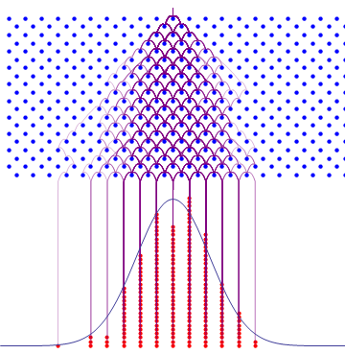
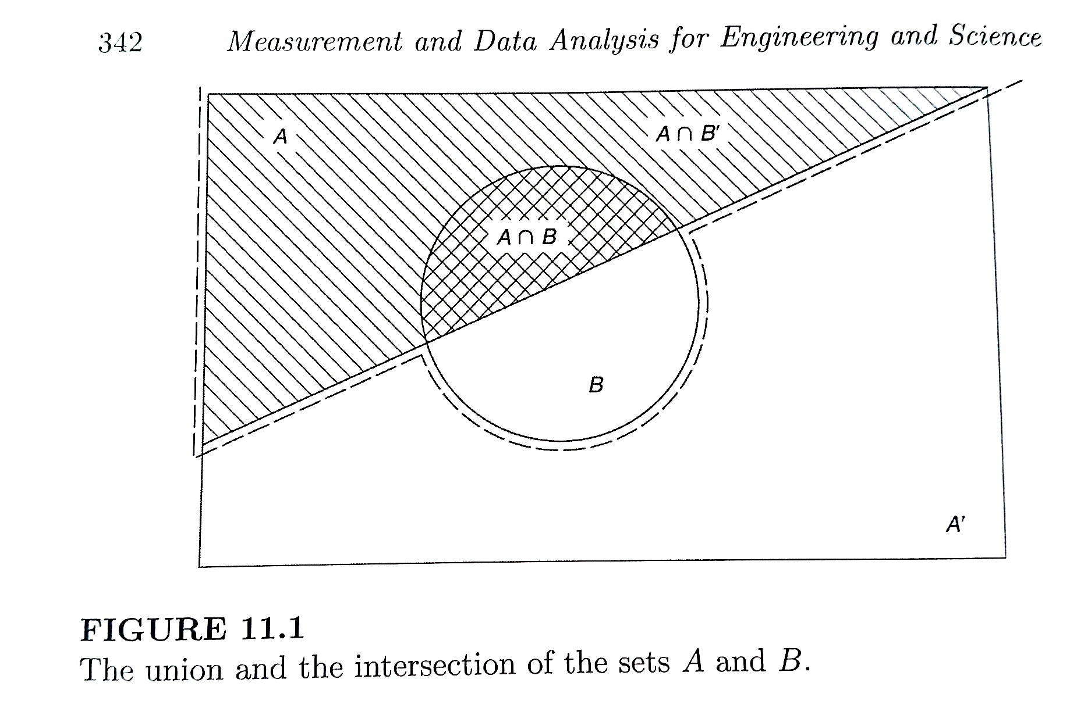
Probability and Statistics

